Slide 1
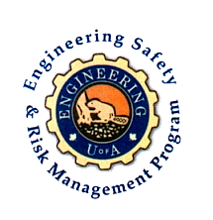
On Becoming a Leader in Risk Management
Fundamentals of RM
RM System and Process
Leadership in RM
Incident Investigation
RM Tools & Challenges
RM in Industry
People & Org.
Application & Perspectives
ENGG404 Lecture
Case 7: BP-Macondo Oilfield and DeepWater Horizon Rig (2010)
1
Notes:
1
ENGG404 Lecture 00 - Day 1
2012 Fall
1
1

Slide 2
Learning Outcomes
Explain that management has the responsibility for sound risk management systems covering both occupational safety and process safety.
Evaluate a loss incident to identify the latent causes and associated management system improvement opportunities.
Case 7: BP-Macondo Deepwater Horizon
2
Notes:
2

Slide 3
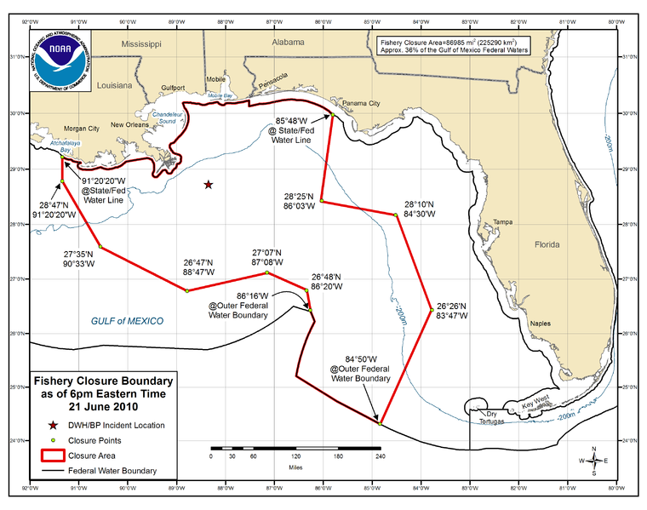
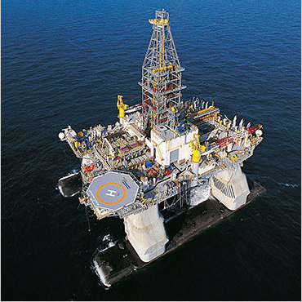
Background
Deep Sub-sea Drilling:
low likelihood of something going wrong, but with extremely high consequence if it does
Three major corporations:
BP Energy: awarded the mineral rights to drill & produce
TransOcean: the rig owner (contracted by BP to drill the well)
Halliburton: well services (under contract to BP for mud & cement)
3
Notes:
3
3

Slide 4
Background
Deepest oil well in history - 35,000 ft
There was a rush to get to production
6 weeks normal versus 21 days target
Previous well into the Macondo formation had to be abandoned because drilling was rushed.
The rig had operated for 7 years without an injury
A great achievement
BP management were on the rig that day to give the crew a safety award
The BOP had been damaged 4 weeks before the incident
Workers were told it wasn’t important, it wasn’t fixed, and operations continued as though it was working properly
Unclear chain of command for changes made to activities
Who was in charge? BP or TransOcean?
4
Notes:
4
4

Slide 5
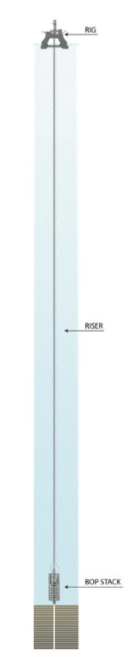
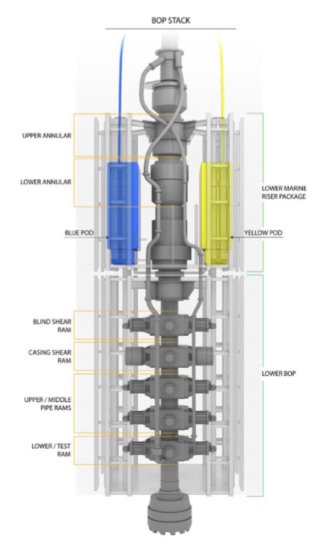
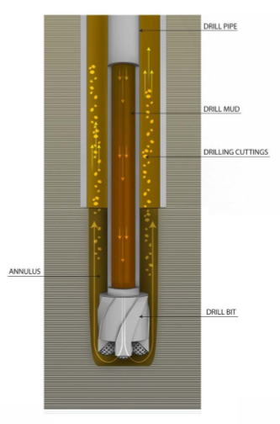
The Basics Of Well Control
5
Notes:
5
5

Slide 6
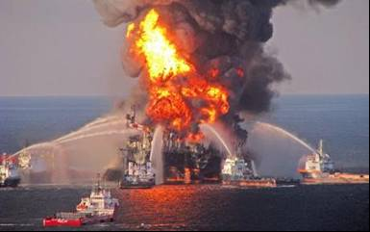
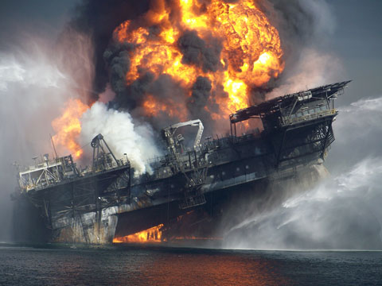
The Loss Incident & Impacts on PEAP
The Loss Incident:
Date: 20-April-2010 to 15-July-2010
Platform: Deepwater Horizon Drilling Rig
Location: The Macondo Prospect, Gulf of Mexico
Corporations: BP plc, TransOcean, Halliburton
Impact on PEAP:
P: 11 killed, 16 seriously injured
E: Inestimable impact
A: Tens of billions of dollars
P: Broad interruptions for US Gulf of Mexico offshore drilling industry; and Significant regulator intervention with regulatory impact
* Prolonged and extensive media coverage (reputational impact)
6
Notes:
6
6

Slide 7
Documentary Videos – Viewed via eClass:
These videos are posted on eClass for viewing prior to the lecture.
Documentary Videos on the BP DWH Blowout, Gulf of Mexico, LA;
US-CSB Video:
00:00-01:20 Introduction and CSB Investigation
01:21-02:35 Technical explanation – drilling, mud, kicks
02:36-03:38 BOP Operation
03:39-04:57 The Kick initiates the incident
04:58-05:24 Buckled Pipe and Effective Compression
CBS News 60 Minutes Video, Part 1:
02:03-03:04 Background
02:18-03:04 Technical explanation - rate of penetration
03:05-04:36 “Tension” – push to do things safely but fast (competing priorities)
CBS News 60 Minutes Video, Part 2:
02:40-7:15 Professor Bob Bea – discussion points akin to “The Engineer’s Survival Guide”
7

Slide 8
Incident Causes
Rush to “get the job done”:
Drilling rate faster than specified for formation
Premature removal of mud before cement plugs were completed
BOP operation was deficient:
Damaged Annular on the Blowout Preventer (BOP)
Inoperative Control Pods on the BOP
Damaged hydraulic line and weak battery on the BOP
Incorrect interpretation of well data (inadequate standards/SOPs):
Process signals of a “kick” ignored (the lead-up prior to a blow-out)
Pressure test to failed to confirm mud and plug integrity (pressure should have remained static/less mud returned to surface)
8
Notes:
8
8

Slide 9
Organizational Factors
Incident happened after drilling & cement job completed
We tend let our guard down at the end of tasks
Transocean had a similar rig incident which demonstrated the need for well monitoring (lower consequences) in the UK just four months prior, but no transfer of lessons to Gulf of Mexico
The major hazards of drilling associated with process safety (containment of hydrocarbons under pressure) lacked management oversight compared to occupational safety
BP experienced a significant process safety-related loss at their Texas City refinery in 2005 but a risk paradigm shift to focus more on process safety was lacking in the BP drilling organization in 2010
Key Lesson: It takes time to change culture!
9
Notes:
9

Slide 10
RME #1 Management Commitment, Leadership & Accountability
The report stated that "whether purposeful or not, many of the decisions that BP, Halliburton, and Transocean made that increased the risk of the Macondo blowout clearly saved those companies significant time (and money).”
Q: What was the priority of management?
In the weeks and days leading up to the loss incident, the priority was getting the well to completion (drilled to depth, and capped) in order to save time and money.
Certainly, there was a priority and focus on occupational safety.
But there was minimal focus on process safety.
Q: What was the evidence for this?
Rushing to complete the drilling work (over budget, behind schedule, focus on costs).
Disregard for critical safety engineered systems for controlling down-hole pressures, detection of leakage, and blow-out prevention.
10
Notes:
10
10

Slide 11
RME #2: Risk Assessment & Management of Risk
No effective safeguards were in place to eliminate the likelihood of or minimize the consequences of a blow-out, a process safety incident.
The safeguards (the mud, steel casing and cement, cement plugs, “kick” detection, cement barrier testing, and BOP) intended to prevent such a disaster were not properly constructed, tested, or maintained, or they had been removed.
The management systems intended to ensure the required functionality, availability, and reliability of these safety-critical safeguards were inadequate.
Ultimately, the safeguards meant to prevent, mitigate, or control a blowout failed on the day of the accident.
11
Notes:
11
11

Slide 12
RME #2: Risk Assessment & Management of Risk
Recall that BP, Transocean, and all other contractor / service companies recognized 7 years without an injury by any worker.
A remarkable achievement, yet there was a catastrophic incident with tragic losses.
The focus (measurement, recognition, reward) was on workplace safety, and much less on process safety.
What gets measured gets managed!
Too often, the means to motivate managers is misdirected with well-meaning goals and targets, but the down-side: what is NOT measured is not well-managed.
Process safety risks associated with the drilling operations & well status were not appropriately considered, evaluated, or managed.
When the pressure was on, process safety management lacked visibility and leadership attention.
12
Notes:
12
12

Slide 13
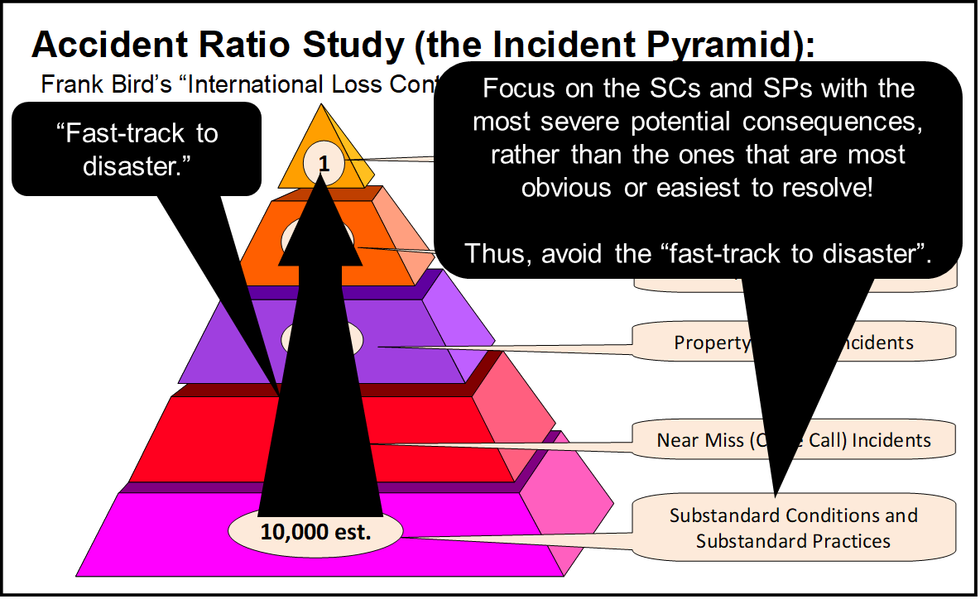
Management Lacked Focus on Process Safety Risks
Leaders must allocate finite resources to make sure high-hazard operations (i.e. with significant process safety hazards) are sustainably managed to acceptable risk exposure levels.
We need to understand our major risks to focus limited resources on the right areas (major hazards) – strategic thinking!
With a clear understanding of our major hazards, we are better prepared to ask the right questions to manage them.
Anomalies that do resolve themselves with no immediate negative consequences are a signal.
Pay attention to the critical “leading indicators” e.g. SC’s and SP’s relating to process safety!
BP and TransOcean were certainly focused on occupational safety, but what about process safety? What signals were available?
13
Notes:
13
13

Slide 14
RME #4: Management of Change
There were differences of opinion on how to seal the well …
The Transocean Manager vs the BP Manager
The BP Manager wanted … because it expedites the process. “Well, my process is different. I think we are going to do it this way.”
It became clear who was ultimately responsible and accountable.
This decision was made despite knowing the deficiencies in the Blowout Preventer (BOP).
The appropriate decision should have been to stop. “Stop. Think. Don’t do something stupid.” Professor Bob Bea
14
Notes:
14
14

Slide 15
RME #6: Program Evaluation & Continuous Improvement
“In fact, post-incident CSB analyses of Transocean and BP risk management policies at the time of the blowout reveal that many of the policies would have satisfied current (legal) requirements.
Yet the companies did not effectively implement these policies to manage the major accident risks of the Macondo well, and the companies were not held accountable by the regulator to ensure that they managed safety as their company policies stipulated.”
15
Notes:
15
15

Slide 16
RME #6: Program Evaluation & Continuous Improvement
Q: What needed to change in order to prevent an incident?
“Implement those ESRM policies” - far easier said than done.
What could we do as leaders to push implementation?
Through Formal Audits, driven by a robust PE&CI program and committed leadership, senior leadership would have discovered that:
Critical changes were being made without adequate, thorough reviews, and
Process safety risks were not being managed to any great degree, certainly not as thorough as were the risks for occupational activities.
Process safety issues (SC’s, SP’s, NM’s, and lower-impact LI’s) were not being investigated nor addressed.
Our management system will only be effective when it is developed, implemented, and maintained through active program evaluation and continuous improvement.
16
Notes:
16
16

Slide 17
Application of the Engineer’s Survival Guide
The report stated that "whether purposeful or not, many of the decisions that BP, Halliburton, and Transocean made that increased the risk of the Macondo blowout clearly saved those companies significant time (and money).”
The Engineer’s Survival Guide:
Understand company values!
Understand your program!
When you make decisions, put safety ahead of any other objective!
Pay attention to failures in safety systems and take action!
Again, another opportunity to apply the Engineer’s Survival Guide:
What was the situation?
What was the issue with that situation?
What Key Point was violated?
What would you have done in that situation?
What would have been the probable outcome had you done it?
17
Notes:
6/26/2019
17
17

Slide 18
Summary & Key Lessons:
Leaders must allocate finite resources to make sure high-hazard operations (i.e. with significant process safety hazards) are sustainably managed to acceptable risk exposure levels.
We need to understand our major risks to focus limited resources on the right areas (major hazards) – strategic thinking!
With a clear understanding of our major hazards, we are better prepared to ask the right questions to manage them.
Anomalies that do resolve themselves with no immediate negative consequences are a signal.
Pay attention to the critical “leading indicators” e.g. SC’s and SP’s relating to process safety!
Our management system will only be effective when it is developed, implemented, and maintained through active program evaluation and continuous improvement.
18
Notes:
18

